Slide 1
ADABOOSTREGRESSOR
MACHINE LEARNING

Slide 2
An AdaBoost regressor is a meta-estimator
That begins by fitting a regressor on the original dataset and then fits additional copies of the regressor on the same dataset
where the weights of instances are adjusted according to the error of the current prediction

Slide 3
APPLICATIONS OF ADABOOSREGRESSOR
AdaBoost is widely used in applications such as face detection, object recognition, and text classification.
It is particularly effective when the data is noisy or when there are many irrelevant features
AdaBoost can also be used in other areas of machine learning, such as regression and clustering.

Slide 4
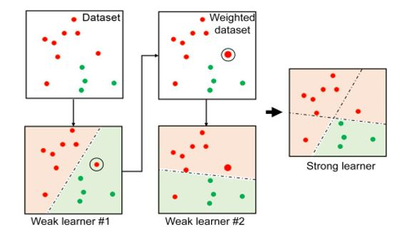
PROCESS

Slide 5
PRINCIPLE
Adaboosting algorithm used to fit a sequence of weak learners on repeatedly re-sampled versions of the data.

Slide 6
Advantages
It is less prone to overfitting
Less parameters tweaking
Helps in reducing bias and variance
Accuracy of weak classifiers can be improved using this method
Easy to use

Slide 7
Disadvantages
It needs a quality dataset
Very sensitive to outliers and noise
Slower than XGBoost
Hyperparameter optimization is much more difficult

Slide 8
XGBOOSTREGRESSOR
Machine learning

Slide 9
XGBoost regression
is a scalable, distributed gradient-boosted decision tree (GBDT) machine learning library
It provides parallel tree boosting and is the leading machine learning library for regression, classification, and ranking problems.
It has been used by data scientists and researchers worldwide to optimize their machine-learning models.
It is designed to be computationally efficient and can quickly train models on large datasets

Slide 10
Application of XGBOOST REGRESSOR
XGBoost is a powerful and widely-used tool for regression tasks, and it has been applied successfully to a variety of real-world problems such as predictive modeling, time series forecasting, and customer churn prediction

Slide 11
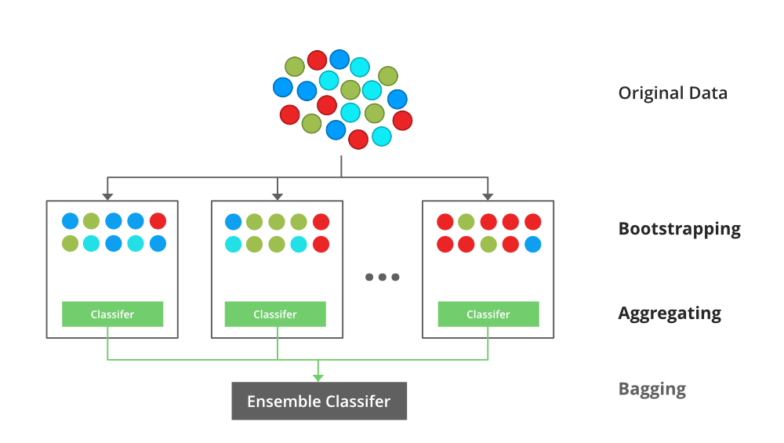
PROCESS

Slide 12
principle
builds a predictive model by combining the predictions of multiple individual models, often decision trees, in an iterative manner
which trains multiple decision trees and then combines the results
provides parallel tree boosting and is the leading machine learning library for regression, classification, and ranking problems. We can use this for large datset
Increase the training process

Slide 13
Advantage
fast and efficient ensemble learning algorithm that has been widely applied in various domains
XGBoost is known for its high accuracy, making it a popular choice for machine learning tasks that require high precision
XGBoost is designed to be fast and efficient, even for large datasets. It is optimized for both single- and multi-core processing
XGBoost is a flexible algorithm that can be used for a variety of machine-learning tasks, including classification, regression

Slide 14
Disadvantage
The loss function of XGBoost is limited to convex functions
which may not be suitable for specific applications that require non-convex loss functions
XGBoost can be computationally inefficient for processing large datasets with complex data structures
hard to interpret the final models.

Slide 15
LGBOOST REGRESSOR
Machine learning

Slide 16
LGBregressor
LightGBM uses a histogram-based method in which data is bucketed into bins using a histogram of the distribution
The bins, instead of each data point, are used to iterate, calculate the gain, and split the data.
The principle of LightGBM revolves around efficiency, scalability, and accuracy

Slide 17
Application of LGBRegressor
LightGBM is used for supervised learning tasks, particularly for classification and regression problems
It is commonly employed in various domains such as finance, healthcare, marketing, and recommendation systems to build predictive models based on structured data

Slide 18
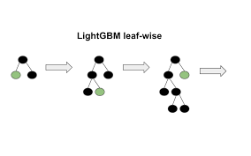
process

Slide 19
Principle
Constructing strong module one by one vertical
LGBM algorithm all trees will grows in vertical, in the model creation every trees will grow with the strong modules at last it will give best model

Slide 20
ADVANTAGES
LightGBM algorithm offers faster training times and higher accuracy compared to other gradient boosting algorithms
LightGBM is designed to optimize memory usage efficiently, allowing it to handle large datasets with minimal memory requirements
LightGBM’s innovative algorithms, such as leaf-wise tree growth and histogram-based learning, contribute to better accuracy in model predictions, resulting in more reliable and precise outcomes

Slide 21
DISADVANTAGES
The algorithm has a certain randomness in parameter selection, making it difficult to determine the optimal combination of parameters .
One potential drawback of LightGBM is its sensitivity to hyperparameters
Training the model may require more time and resources compared to simpler algorithms

